Slide 1
Real-Time Lighting Calculations & Materials
DirectX Day 6

Slide 2
HLSL: D3D shader models
1.X ( D3D8 )
Very first shader model D3D8. Was written in shader assembly.
128 instructions, no branching.
2.X ( D3D9 )
Introduced HLSL, 256 instructions, static branching.
3.0 ( D3D9 )
65535+ instructions, dynamic branching, HDR color, Multiple Render Targets (4 minimum), Vertex Texture Fetch, Instancing.
4.0 ( D3D10 )
Superset of 3.0, Unlimited Instructions, Templates, New geometry shaders allowing the generation of extra geometry on the fly.
5.0 ( D3D11 )
Hardware Tessellation, The Compute Shader, New buffer types.

Slide 3
HLSL: Static Branching
Shader behavior changes based on a value in a Constant Buffer.
All components take the same path because Constant Buffers do not change mid-draw.
Not the same as #define pre-processor shader branching.

Slide 4
HLSL: Dynamic Branching
Shaders can change per component based on data gathered in those operations.
Examples of dynamic data might be:
Per-Vertex/Pixel/Primitive input values.
Vertex/Pixel/Primitive/Instance ID values.
Values looked up from a texture or buffer.
Any value computed from above values.
Expensive, avoid if possible. But if used correctly can sometimes provide a performance benefit on complex shaders.
EX: Detect shadowed pixel, skip lighting.

Slide 5
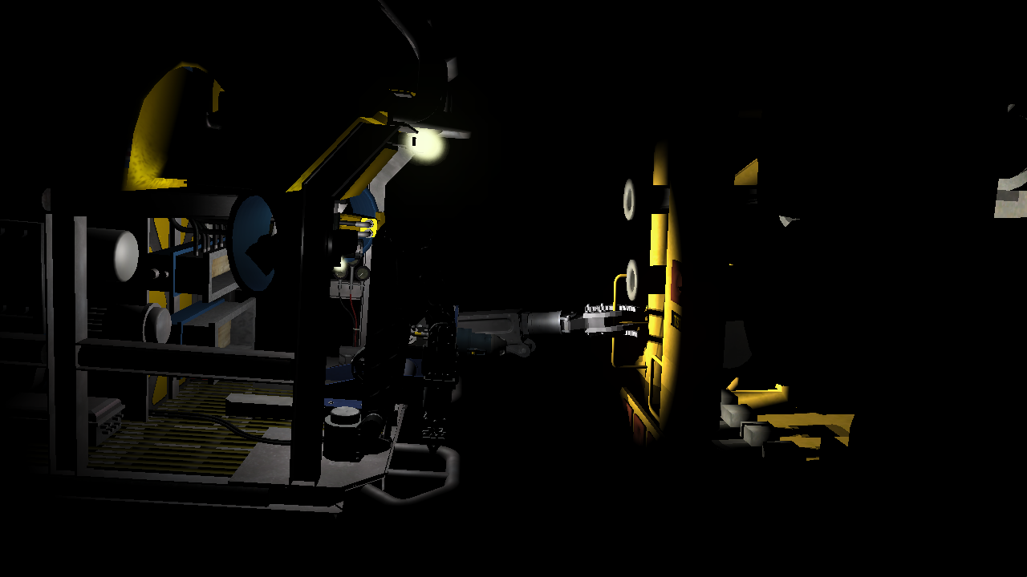
Lighting and Materials

Slide 6
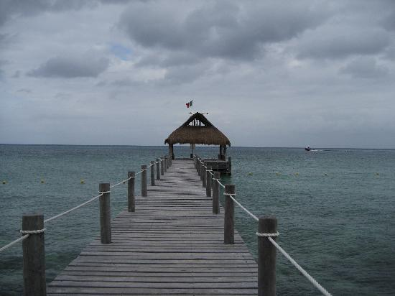

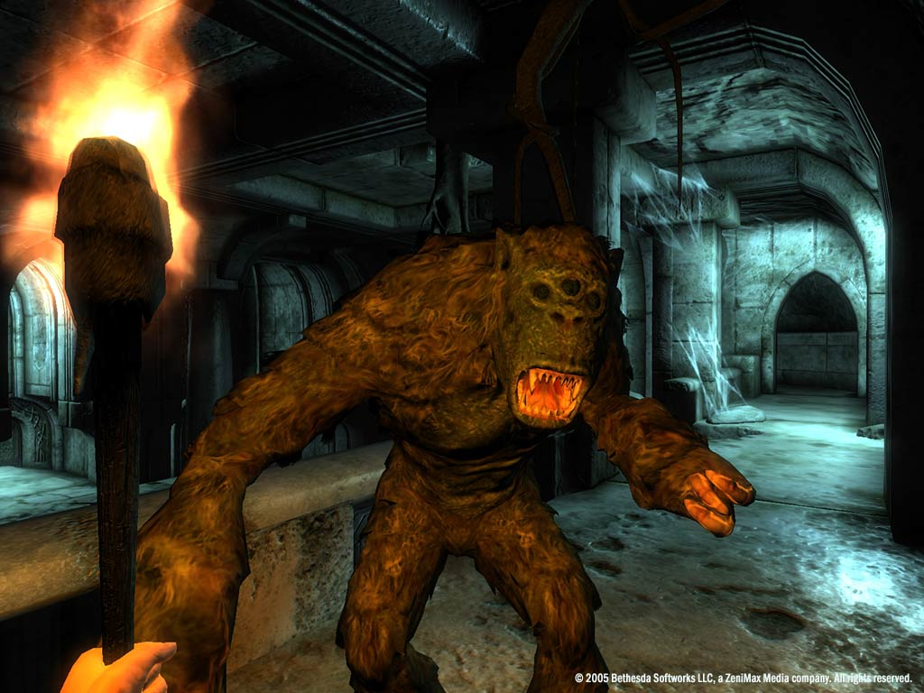
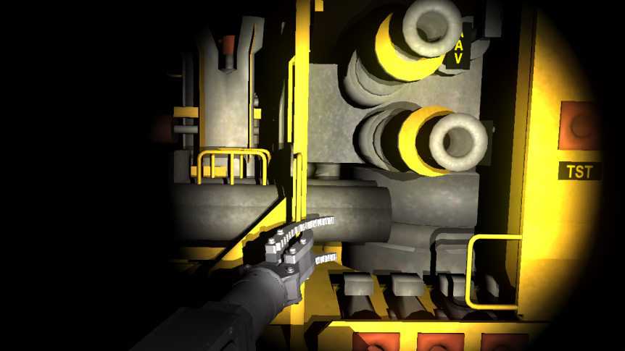
Lighting: Kinds of Lighting
DIRECTIONAL
AMBIENT
POINT LIGHTING
SPOT LIGHTING

Slide 7
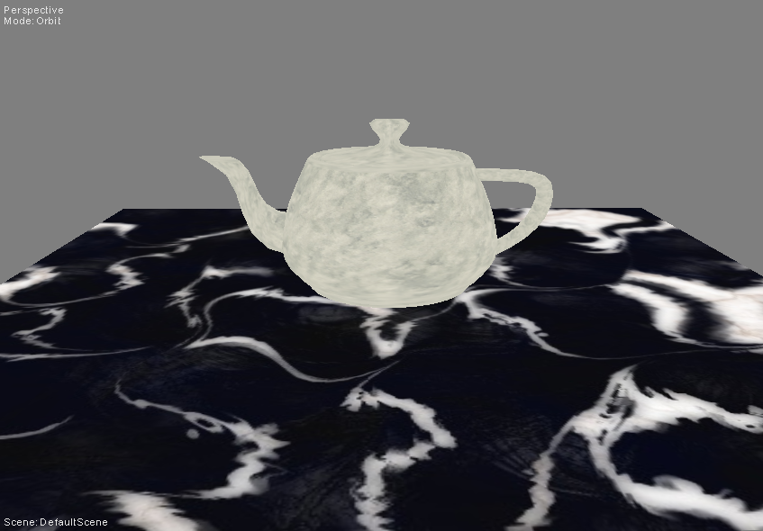
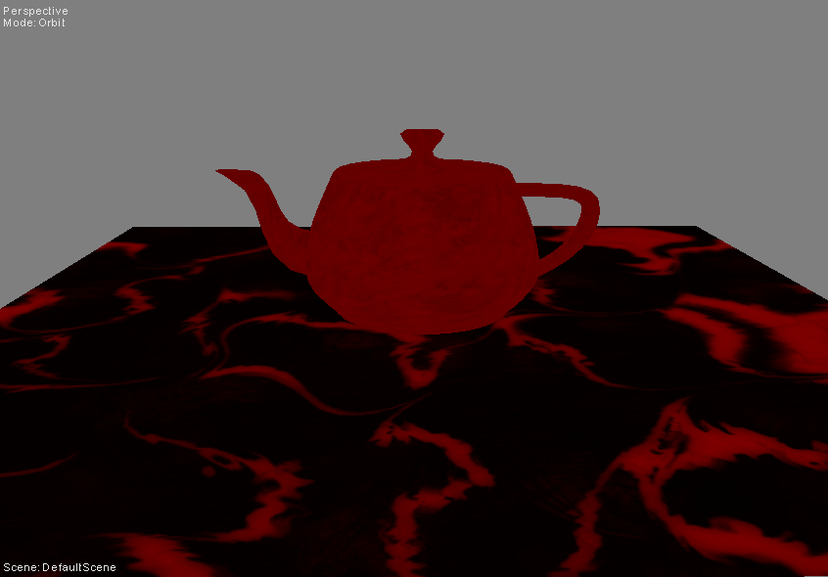
Ambient Formula
RESULT = LIGHTCOLOR * SURFACECOLOR
Surface Color from Texture
Ambient Light Color of 0.5r 0g 0b 1.0a * Surface Color

Slide 8
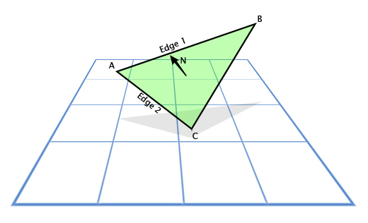
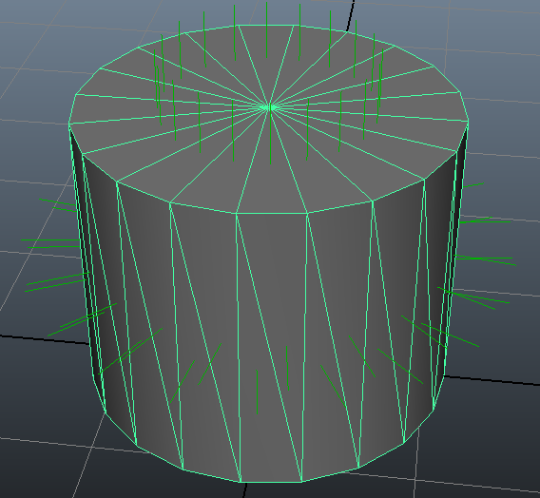
Lighting: Surface Normals
All lighting models except Ambient must know what direction a surface is facing in order to calculate how much light reaches that surface.
This data is typically stored per vertex and is known as vertex normals.
This data is calculated off-line and stored in the vertex stream so it can be used by the various lighting equations in real-time.(vertex & pixel shaders)
N = NORMALIZE( CROSS( A-B, A-C ) )

Slide 9
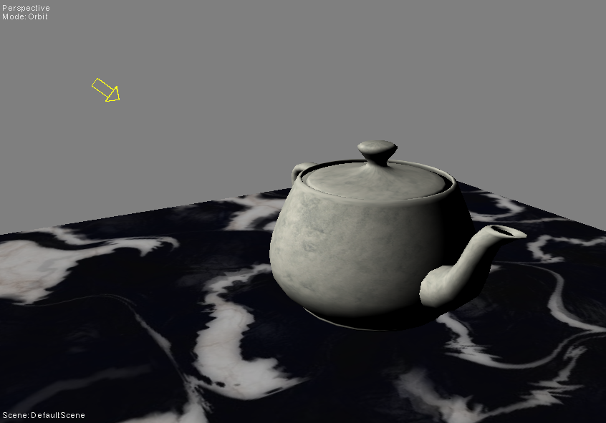
Directional Light Formula
LIGHTRATIO = CLAMP( DOT( -LIGHTDIR, SURFACENORMAL ) )
RESULT = LIGHTRATIO * LIGHTCOLOR * SURFACECOLOR

Slide 10
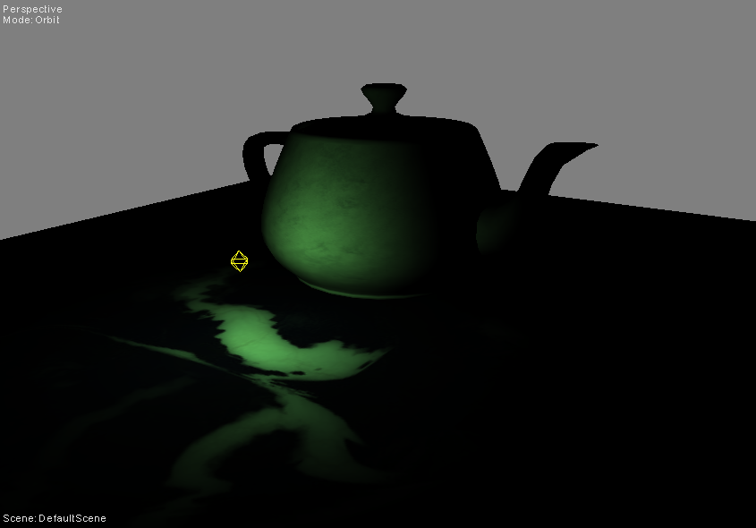
Point Light Formula
LIGHTDIR = NORMALIZE( LIGHTPOS – SURFACEPOS )
LIGHTRATIO = CLAMP( DOT( LIGHTDIR, SURFACENORMAL ) )
RESULT = LIGHTRATIO * LIGHTCOLOR * SURFACECOLOR

Slide 11
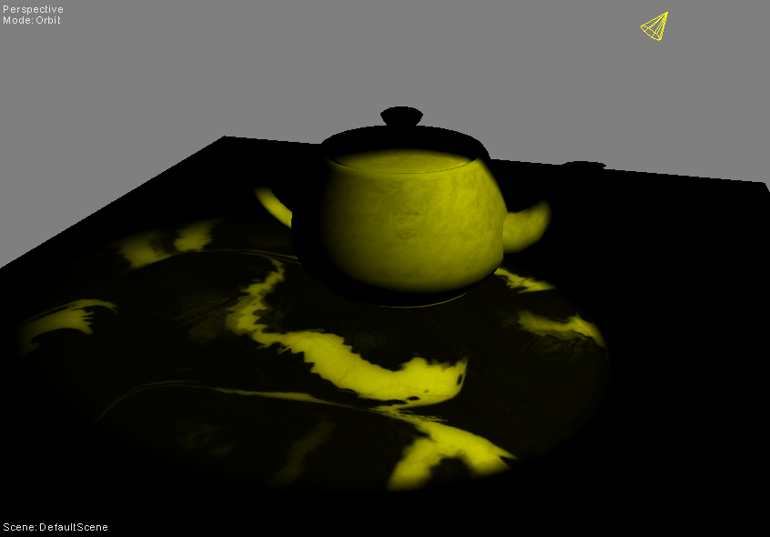
Spotlight Formula
LIGHTDIR = NORMALIZE( LIGHTPOS – SURFACEPOS ) )
SURFACERATIO = CLAMP( DOT( -LIGHTDIR, CONEDIR ) )
SPOTFACTOR = ( SURFACERATIO > CONERATIO ) ? 1 : 0
LIGHTRATIO = CLAMP( DOT( LIGHTDIR, SURFACENORMAL ) )
RESULT = SPOTFACTOR * LIGHTRATIO * LIGHTCOLOR * SURFACECOLOR

Slide 12
Linear Light Attenuation
For Point and Spotlights. (optional)
For attenuating the inner to outer edge of a spotlight.
To make any falloff quadratic, simply multiply the attenuation by itself.
ATTENUATION = 1.0 – CLAMP( MAGNITUDE( LIGHTPOS – SURFACEPOS ) / LIGHTRADIUS )
ATTENUATION = 1.0 – CLAMP( ( INNERCONERATIO - SURFACERATIO ) / ( INNERCONERATIO – OUTERCONERATIO ) )

Slide 13
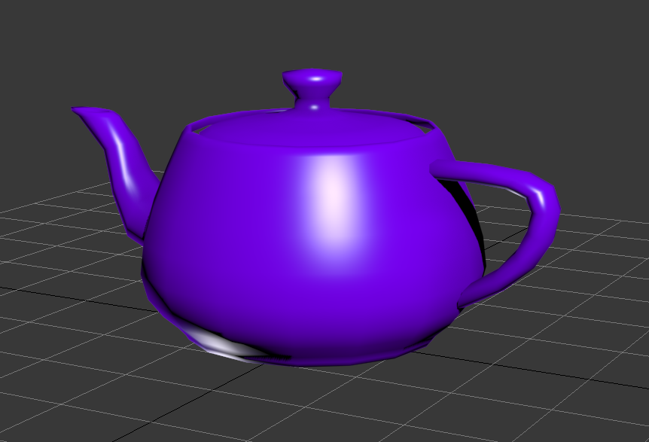
Specular Formula
Specular highlights represent light that is reflected from a shiny surface to your eye. This adds an extra level of detail & realism to your lights.(ADD this to your normal lights output)
VIEWDIR = NORMALIZE( CAMWORLDPOS – SURFACEPOS )
HALFVECTOR = NORMALIZE((-LIGHTDIR ) + VIEWDIR)
INTENSITY = MAX( CLAMP( DOT( NORMAL, NORMALIZE(HALFVECTOR) ))^{SPECULARPOWER} , 0 )
RESULT = LIGHTCOLOR * SPECULARINTENSITY * INTENSITY

Slide 14
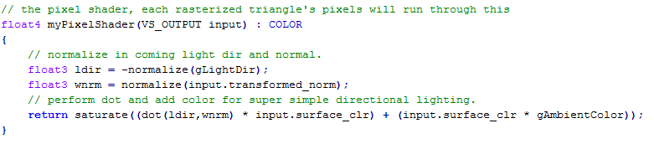
HLSL: Lighting in the pixel shader
Lighting in the pixel shader is a great way to ensure the quality of lighting in your scene regardless of the geometric complexity of your objects.
Lighting in the pixel shader can also open doors to more advanced techniques such as normal mapping and texture based specularity.
Because the lighting algorithms run per-pixel it is very important to try and optimize your formulas at much as possible and not waste time shading hidden pixels.(research early-Z rejection)
SV_TARGET

Slide 15
Materials
In the past, lighting and shading algorithms were fixed on the hardware. So typically you would see a set of fixed values that controlled the behavior of these functions stored alongside model data.
Ex: Diffuse Color, Specular Color, Specular Pwr, Emissive Color…
These days the shading algorithms are up to us. As are the various parameters and values that we use to affect their final outcome. Though oftentimes many of our shaders will utilize some of these past fixed behaviors in new and exciting ways.
Ex: Specular Texture, Reflection Enable, Normal Map Scale…

Slide 16
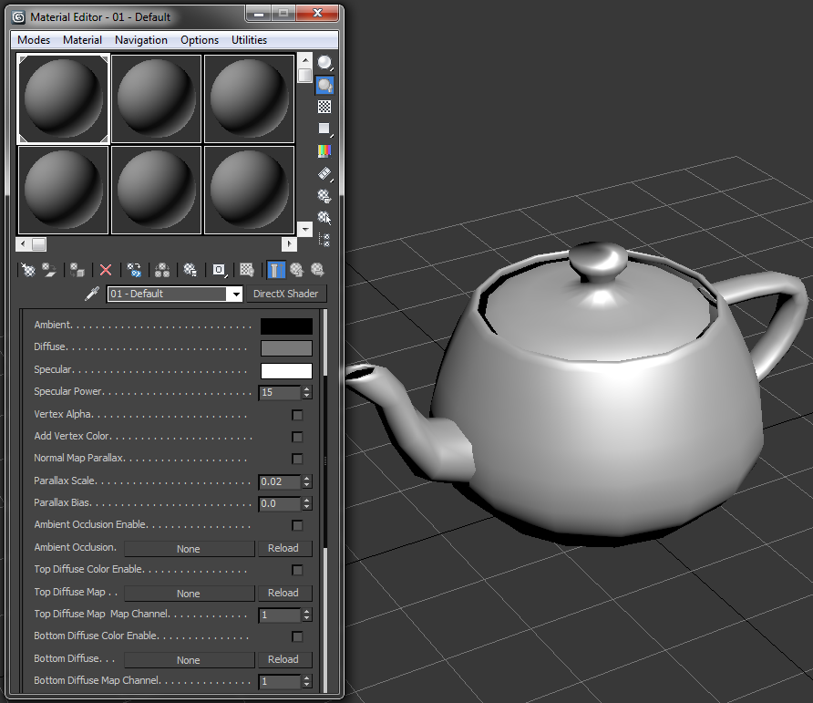
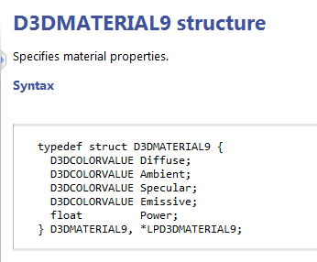
Materials: Old vs New

Slide 17
Homework Tips: OBJ Files
If you want to pass this class, you will need to write an OBJ loader at some point. (The sooner the better!)
There are some great tutorials out there on how to load an OBJ file.
Even though examples may be written in OpenGL does not mean they aren't relevant to DirectX.
For my class you only need to support loading single objects with Positions, Normals, and UV coordinates.
Tips: OBJ indices are 1 based. The OBJ (V) of “UV” coordinates is inverted in DirectX.

